Slide 1
AGENDA …
  Software Engineering Management
Software Process & Product Quality
CISH-6050 - Software Engineering Management

Slide 2
The Software Crisis
What is it?
CISH-6050 - Software Engineering Management

Slide 3
Course Objectives
To learn about all the difficulties in developing software so that we can avoid pitfalls and myths in software design
To learn about different software processes so that we can choose a suitable one
To learn to design high-quality efficient software so that it is usable and maintainable
To learn about advanced methods for software engineering

Slide 4
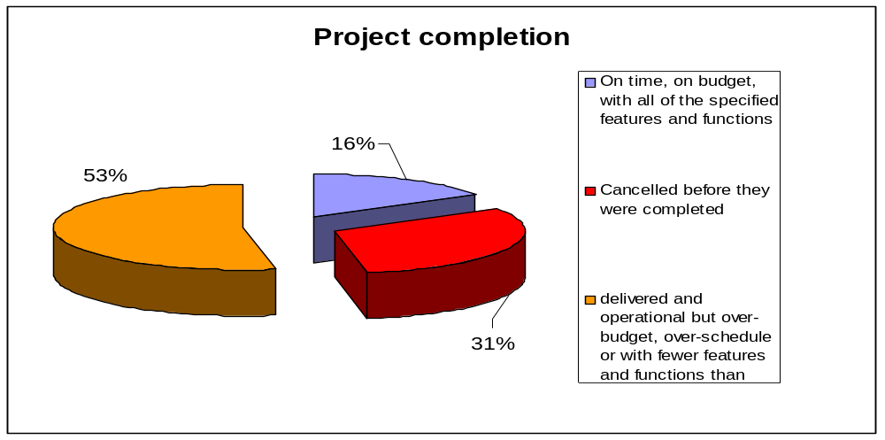
The statistics – Chaos Report
Standish Group – 1995
365 IT executives in US companies in diverse industry segments.
8,380 projects
In Averages
189% of original budget
221% of original schedule
61% of original functionality
average time overrun = 222%.
  61% of originally specified features included
✓
?
×
average cost overrun = 189%

Slide 5
Symptom of Software Crisis
About US$250 billions spent per year in the US on application development
Out of this, about US$140 billions wasted due to the projects getting abandoned or reworked; this in turn because of not following best practices and standards
Ref: Standish Group, 1996

Slide 6
Symptom of Software Crisis
10% of client/server apps are abandoned(having been deserted or left) or restarted from scratch
20% of apps are significantly altered to avoid disaster
40% of apps are delivered significantly late
Source: 3 year study of 70 large c/s apps 30 European firms.
Compuware (12/95)

Slide 7
Observed Problems
Software products:
  fail to meet user requirements
  crash frequently
  expensive
  difficult to alter, debug, enhance
  often delivered late
  use resources non-optimally

Slide 8
Why is the Statistics so Bad?
Misconception on software development
  Software myths, e.g., the man-month myth
  False assumptions
  Not distinguishing the coding of a computer program from the development of a software product
Software programs have exponential growth in complexity and difficulty level with respect to size.
  The ad hoc approach(solution designed for a specific problem or task, non-generalizable) breaks down when size of software increases.

Slide 9
Why is the Statistics so Bad?
Software professionals lack engineering training
  Programmers have skills for programming but without the engineering mindset about a process discipline
Internal complexities

Slide 10






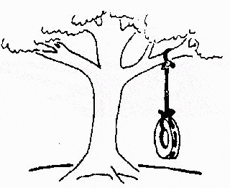
How is Software usually Constructed …
The requirements specification was defined like this
The developers understood it in that way
This is how the problem was solved before.
This is how the problem is solved now
That is the program after debugging
This is how the program is described by marketing dept.
This, in fact, is what the customer wanted … ;-)

Slide 11
Software Crisis Examples …
Bank of America – MasterNet
  Spent $23M on an initial 5 year accounting & reporting system
  Spent $600M trying to make it work
  Project cancelled
  Lost customer accounts - $Billons
CISH-6050 - Software Engineering Management

Slide 12
Software Crisis Examples …
Allstate Insurance – In 1982
  $8M computer system to automate business
  EDS( Electronic Data Systems ) providing software
  Initial 5 year project continued for 10 years, until 1993
  Cost approached $100M
CISH-6050 - Software Engineering Management

Slide 13
Software Crisis Examples …
Blue Cross and Blue Shield of Wisconsin - 1983
  EDS hired to build $200M computer system
  Delivered on time in 18 months
  System didn’t work – issued $60M in overpayments and duplicate checks
  BC lost 35,000 policy holders by 1987
CISH-6050 - Software Engineering Management

Slide 14
Software Crisis Examples …
Therac-25: 1985 - 1987
  Computerized radiation therapy machines made by Atomic Energy Canada Limited (AECL)
  Massive radiation overdoses by the Therac-25 between 6/85 and 1/87
  4 deaths and serious injuries
  Original User Interface faulty, allowing techs to administer high dosages
CISH-6050 - Software Engineering Management

Slide 15
The Software Crisis
Software development projects suffering from:
  Cost overruns
  Schedule delays
  Reduced functional deliverables
  Potential project cancellation
CISH-6050 - Software Engineering Management

Slide 16
Software Crisis Stats
Standish Group ‘94 CHAOS Report:
  The US spends $250B on IT projects
  31.3% of projects will be cancelled before being completed
  52.7% will cost 189% of original est.
  78.4% of software projects deployed with at least 74.2% of features
  $140B in project waste
CISH-6050 - Software Engineering Management

Slide 17
The Software Crisis
How did it start?
CISH-6050 - Software Engineering Management

Slide 18
The Software Crisis History
1950s and 1960s – Programs are procedures to run hardware
  Procedural, sequential thought process
  Assembler level coding languages
  Modules, interfaces, state machines, data abstractions, etc. not familiar concepts to most practitioners
CISH-6050 - Software Engineering Management

Slide 19
The Software Crisis History …
  Procedurally coded instructions led to subroutines and macros
  Monitor programs evolved that could invoke and provide services to other programs
  Late 1960s, Monitor programs evolved to operating systems
CISH-6050 - Software Engineering Management

Slide 20
The Software Crisis History …
Late 1960s – Operating Systems
  Utility programs developed for repeated data manipulation
  FORTRAN and COBOL
  Assembler programs with I/O devices called at machine lang level
  New subsystems - Databases to handle mass of data
CISH-6050 - Software Engineering Management

Slide 21
The Software Crisis History …
1970s – Software Properties
  Complex
    Rapid growth in size of apps
  Error Prone
    Inherited ‘spaghetti’(source code that has a complex & tangled control structure) code
  Labor-intensive
    Very few good development tools
CISH-6050 - Software Engineering Management

Slide 22
The Software Crisis History …
Cost overruns become the norm
  Software complex, labor intensive, and high volume of errors
  More time needed than planned to develop code
More focus needed
  How software developed
  Process of developing software
CISH-6050 - Software Engineering Management

Slide 23
The Software Crisis History …
1970s - concepts & practices developed to manage size and complexity
  Lifecycle models
  Defect detection earlier in cycle
  Improved testing methodologies
  Design and code inspections
  Program proof of correctness
CISH-6050 - Software Engineering Management

Slide 24
The Software Crisis History …
Despite improvements from the 1970s to 1980s, investing in software development still viewed as “bottomless pit”
  Highly error prone
  Labor-intensive
  Cost overruns
CISH-6050 - Software Engineering Management

Slide 25
The Software Crisis History …
Early 1980s – hardware costs decreased
Software development & service dominating cost factor
Led to shift in industry:
  Defect Prevention
  Defect Removal
  Software Development Tools
CISH-6050 - Software Engineering Management

Slide 26
The Software Crisis – Why?
“The most likely way for the world to be destroyed, most experts agree, is by accident. That's where we come in; we're computer professionals. We cause accidents."
- Nathaniel Borenstein
CISH-6050 - Software Engineering Management

Slide 27
The Software Crisis – Why?
Why are late deliverables and poor quality tolerated?
For other items:
  Defects not tolerated – cars, appliances, homes, etc.
  High quality expected
  Compensation for defects
  Contractual obligation
CISH-6050 - Software Engineering Management

Slide 28
The Software Crisis – Why?
Arguments – Valid or Invalid?
  Software is an art form; planning and cost management will damage creativity.
  Defect-free software can’t be produced.
CISH-6050 - Software Engineering Management

Slide 29
The Software Crisis – Why?
How long will this be tolerated?
  Until someone does it better
  Until the defects cause damage
If there are no improvements and customers don’t suffer intolerable pain, the market place could continue as it has
CISH-6050 - Software Engineering Management

Slide 30
The Software Crisis - Improving
General public no longer shielded from computers or software:
  Critical component in products
    Brakes cars, flies planes, manages financial transactions, runs machinery, etc.
  General public more intolerant of software flaws
CISH-6050 - Software Engineering Management

Slide 31
The Software Crisis - Improving
Is the Software Crisis real?
  Really a crisis?
Did (or will) it escalate as originally predicted?
If it’s improving, is it over now?
CISH-6050 - Software Engineering Management

Slide 32
The Software Crisis - Improving
Software Engineering and Software Engineering Management are a continued effort against the Software Crisis
Software and Software Engineering Basics
CISH-6050 - Software Engineering Management

Slide 33
Software Myths
(Customer Perspectives)
A general statement of objectives is sufficient to get started with the development of software. Missing/vague requirements can easily be incorporated/detailed out as they get concretized.
Application requirements can never be stable; software can be and has to be made flexible enough to allow changes to be incorporated as they happen.

Slide 34

Software Myths
(Developer Perspectives)
Once the software is demonstrated, the job is done.
Usually, the problems just begin!

Slide 35
Software Myths
(Developer Perspectives)
Until the software is coded and is available for testing, there is no way for assessing its quality.
Usually, there are too many
tiny bugs inserted at every stage
that grow in size and complexity
as they progress thru further stages!

Slide 36
Software Myths
(Developer Perspectives)
The only deliverable for a software development project is the tested code.
The code is only
the externally visible component
of the entire software complement!

Slide 37
Software Myths
(Management Perspectives)
As long as there are good standards and clear procedures in my company, I shouldn’t be too concerned.
But the proof of the pudding
is in the eating;
not in the Recipe !

Slide 38
Software Myths
(Management Perspectives)
As long as my software engineers(!) have access to the fastest and the most sophisticated computer environments and state-of-the-art software tools, I shouldn’t be too concerned.
The environment is
only one of the several factors
that determine the quality
of the end software product!

Slide 39
Software Myths
(Management Perspectives)
When my schedule slips, what I have to do is to start a fire-fighting operation: add more software specialists, those with higher skills and longer experience - they will bring the schedule back on the rails!
Unfortunately,
software business does not
entertain schedule compaction
beyond a limit!

Slide 40
Misplaced Assumptions
All requirements can be pre-specified
Users are experts at specification of their needs
Users and developers are both good at visualization
The project team is capable of unambiguous communication
Ref: Larry Vaughn

Slide 41
Confused with Programs and Products
Programs
Software Products
Usually small in size
Author himself is sole user
Single developer
Lacks proper user interface
Lacks proper documentation
Ad hoc development.
Large
Large number of
users
Team of developers
Well-designed interface
Well documented & user-manual prepared
Systematic development

Slide 42
Software Programming ≠ Software Engineering
Software programming: the process of translating a problem from its physical environment into a language that a computer can understand and obey. (Webster’s New World Dictionary of Computer Terms)
  Single developer
  “Toy” applications
  Short lifespan
  Single or few stakeholders
    Architect = Developer = Manager = Tester = Customer = User
  One-of-a-kind systems
  Built from scratch
  Minimal maintenance

Slide 43
Software Programming ≠ Software Engineering
Software engineering
  Teams of developers with multiple roles
  Complex systems
  Indefinite lifespan
  Numerous stakeholders
    Architect ≠ Developer ≠ Manager ≠ Tester ≠ Customer ≠ User
  System families
  Reuse to amortize costs
  Maintenance accounts for over 60% of overall development costs

Slide 44
What is Software?
Software is a set of items or objects
that form a “configuration” that
includes
• programs
• documents
• data ...
(“Software Engineering- a practitioner’s approach,” Pressman, 5ed. McGraw-Hill)

Slide 45
What is Software (ctd.)?
Or you may want to say:
  Software consists of
    (1) instructions (computer programs) that when executed provided desired function and performance,
    (2) data structures that enable the programs to adequately manipulate information, and
    (3) documents that describe the operation and use of the programs.
Notes:
這些都是具像的，但軟體真正有價值的部分是抽像的。

Slide 46
What is Software (ctd.)?
But these are only the concrete part of software that may be seen, there exists also invisible part which is more important:
  Software is the dynamic behavior of programs on real computers and auxiliary equipment.
  “… a software product is a model of the real world, and the real world is constantly changing.”
  Software is a digital form of knowledge. (“Software Engineering,” 6ed. Sommerville, Addison-Wesley, 2000)

Slide 47
Unique Characteristics of Software
Software is malleable
Software construction is human-intensive
Software is intangible and hard to measure
Software problems are usually complex
Software directly depends upon the hardware
  It is at the top of the system engineering “food chain”
Software doesn’t wear out but will deteriorate
Software solutions require unusual rigor
Software has discontinuous operational nature

Slide 48
Casting the Term
The field of software engineering was born in NATO Conferences, 1968 in response to chronic failures of large software projects to meet schedule and budget constraints
Since then, term became popular because software is getting more and more important to industry and business but the “software crisis” still persists.

Slide 49
What is Software Engineering?
Different focuses for this term exist in various textbooks. Some are listed below.
The application of a systematic, disciplined, quantifiable approach to development, operation, and maintenance of software; that is, the application of engineering to software. (IEEE Standard Computer Dictionary, 610.12, ISBN 1-55937-079-3, 1990)

Slide 50
What is Software Engineering? (ctd)
Software engineering is concerned with the theories, methods and tools for developing, managing and evolving software products. (I. Sommerville, 6ed.)
A discipline whose aim is the production of quality software, delivered on time, within budget, and satisfying users' needs. (Stephen R. Schach, Software Engineering, 2ed.)
Multi-person construction of multi-version software (Parnas, 1987)

Slide 51
What is Software Engineering? (ctd.)
The practical application of scientific knowledge in the design and construction of computer programs and the associated documentation required to develop, operate and maintain them (B.W. Boehm)
The establishment and use of sound engineering principles in order to obtain economically software that is reliable and works efficiently on real machines (F.L. Bauer)

Slide 52
What is Software Engineering? (ctd.)
The technological and managerial discipline concerned with systematic production and maintenance of software products that are developed and modified on time and within cost constraints (R. Fairley)
A discipline that deals with the building of software systems which are so large that they are built by a team or teams of engineers (Ghezzi, Jazayeri, Mandrioli)

Slide 53
Other Definitions of Software Engineering
“A systematic approach to the analysis, design, implementation and maintenance of software.” (The Free On-Line Dictionary of Computing)
“The systematic application of tools and techniques in the development of computer-based applications.” (Sue Conger in The New Software Engineering)
“Software Engineering is about designing and developing high-quality software.” (Shari Lawrence Pfleeger in Software Engineering -- The Production of Quality Software)

Slide 54
So, Software Engineering is …
Scope
  study of software process, development principles, techniques, and notations
Goals
  production of quality software,
  delivered on time,
  within budget,
  satisfying customers’ requirements and users’ needs

Slide 55
Software Process
Waterfall life cycle
Prototyping
Spiral model
Automatic synthesis model
Object-oriented model
4 GL model

Slide 56
Traditional Software Engineering
Software Systems
Function
Data
Behavior
Data Flow
Diagram
Entity-Relation
Diagram
State Transition
Diagram

Slide 57
Object-Oriented Software Engineering
Software Systems
Object
Function
Behavior
Class
Diagram
Data Flow
Diagram
State Chart

Slide 58
Evolution of Software Industry
Independent Programming Service
Software Product
Enterprise Solution
Packaged Software for the Mass

Slide 59
Independent Programming Services (Era 1)
Feb 1955, Elmer Kubie and John Sheldon founded CUC
  the First Software Company that devoted to the construction of software especially for hardware company.
Promoting Software Industry: two Major Projects,
  SABRE, airline reservation system, $30 million.
  SAGE, air defense system (1949~1962)
  700/1000 programmers in the US. $8 billion.

Slide 60
Software Product (Era 2)
1964 Martin Goetz developed Flowchart Software -- Autoflow for RCA, but rejected.
    Sale to the customer of RCA & IBM.
    Develop and market software products not specifically designed for a particular hardware platform.
  MARK IV, a pre-runner for the database management system.
IBM unbundled software from hardware.

Slide 61
Enterprise Solutions (Era 3)
Dietmar Hopp. IBM Germany
  Systems, Applications and Products (SAP) $3.3billion (1997)
  Setting up shop in Walldorf, Germany.
  Marked by the emergence of enterprise solutions providers.
  e.g. Baan 1978. Netherlands. $680 million (1997)
  Oracle 1977. U.S.
  Larry Ellison.
  ERP, $45 billion (1997)

Slide 62
Packaged Software for the Masses
(Era 4)
Software products for the masses. 1979.
  VisiCalc, Spreadsheet program.
August 1981: The deal of the century.
  Bill Gates bought the first version of the OS from a small firm called Seattle Computer Products for $50,000 without telling them it was for IBM.
  The development of the IBM PC, 1981, initiated a 4th software era.
    PC-based mass-market software. Few additional services are required for installation.
  Microsoft reached revenues of $11.6 billion. Packaged Software Products, $57 billion (1997)

Slide 63
Internet Software and Services (Era 5)
Internet and value-added services period, 1994. W
  with Netscape’s browser software for the internet.

Slide 64
Evolution of Design Techniques
Object-Oriented
Data flow-based
Data structure-based
Control flow-based
Ad hoc

Slide 65
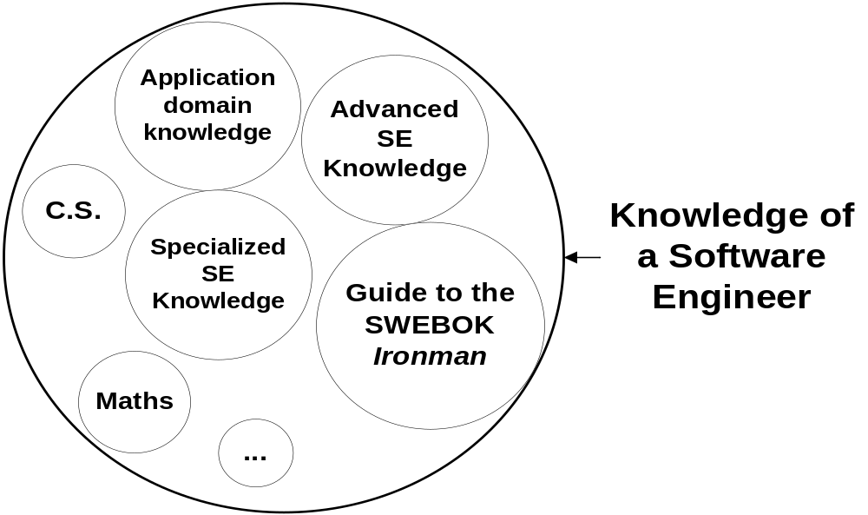
Related Knowledge

Slide 66
IT Market
Hardware
products
Hardware
maintenance
Software Products
& Services
Processing Services
and Internet Services
Embedded
Software
Professional
Service
Software
Products
Enterprise
Solution
Packaged
Mass-Market
Software

Slide 67
Software Products and Services
Professional Software
Services
Anderson Consulting
IBM
EDS
CSC
Science Applications
Cap Gemini
Hp
DEC
Fujitsu
BSO Origin
Enterprise
Solutions
IBM
Oracle
Computer Associates
SAP
HP
Fujitsu
Hitachi
Parametric Technology
People Soft
Siemens
Packaged Mars-Market
Software
Microsoft
IBM
Computer Associates
Adobe
Novell
Symantec
Intuit
Autodesk
Apple
The Learning Company

Slide 68
Software Engineering Today?
Organizations “go with what has worked in the past”
Everyone is too busy getting product out the door to spend time in education or training or addressing these problems effectively
“Out of date” practices become institutionalized

Slide 69
Software Engineering Today?
Few people know, or can integrate, best practices
  Unable to adopt and utilize proven methodologies in timely fashion
Although significant improvements have been made in specific areas, the rapidly evolving nature of the software industry has resulted in little overall improvement in the overall situation.

Slide 70
Not Crisis, but a Chronic Problem
The crisis persists
  After 35 years later, the software “crisis” is still with us
  Major problems are still the same:
    poor quality (correctness, usability, maintainability, etc)
    over budget
    delivered late, or not at all
It is not a crisis but a chronic problem
  It becomes a persistent, chronic condition that software industry has to face with

Slide 71
What’s Wrong?
Does software engineering have no progress at all? Not quite true.
  We have indeed seen a lot of improvements, e.g. high level programming, object-oriented technology, etc.
But it does not achieve its promise, why?
  production of fault-free software, delivered on time and within budget, that satisfies the users’ needs, and is easy to maintain, etc.

Slide 72
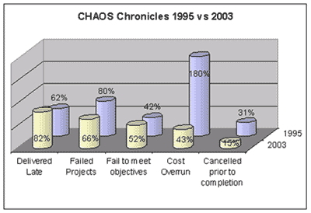
A More Close Look
The comparison with 1995’s report does show that there is some progress in the past eight years.
Notes:
As we can see, there indeed has some slow improvements in the software development. So what’s wrong with the problem?

Slide 73
So, What’s the Problem?
Software issues: software industry has changes a lot in the past years
Education issue: more emphasis on methods and tools but lack of sufficient education and training on people
Process and quality issue: there lacks of a set of known proven practices for software engineers to follow with

Slide 74
Software Changes in the Past Years
Changes in software over time:
  grew in size from 10’s or 100’s of lines to 1000’s to 1,000,000’s of lines of code
  operating environment changed from simple “batch” operations to complex multiprogramming systems, to time-sharing and distributed computing to today’s Internet network computing environment.

Slide 75
Software Changes in the Past Years
As computer systems (both hardware and software) have become larger and more complex, the software development process has also become more and more complex
  the simple art of “programming in the small” is no longer capable of coping with the task.

Slide 76
Situations for Software are Different Too
Driven by intense market forces, including persistent pressure to deliver software on unrealistic time schedules
  Rapidly changing requirements
  Pressures for faster time to market
Continuing rapid evolution of software methodologies and systems
  Integration of new processes and techniques
  Need to re-design major systems

Slide 77
Situations for Software are Different Too
Talent shortage: needed software engineering skills often in short supply
What even worse
  Moore’s law means always trying new things
  Complexity moves into software
  Can’t find the limits except by trial and error

Slide 78
The Software Industry Today
Even though much is now known about how to improve software production, the overall state is not much better than ever, due to the urgency of meeting unrealistic delivery schedules and the continuing rapid evolution of the software industry
  i.e. poor quality, late delivery, over budget

Slide 79
The Software Industry Today
Component-Based Engineering and Integration
Technological Heterogeneity
Enterprise Heterogeneity
Greater potential for Dynamic Evolution
Internet-Scale Deployment
Many competing standards
Much conflicting terminology

Slide 80
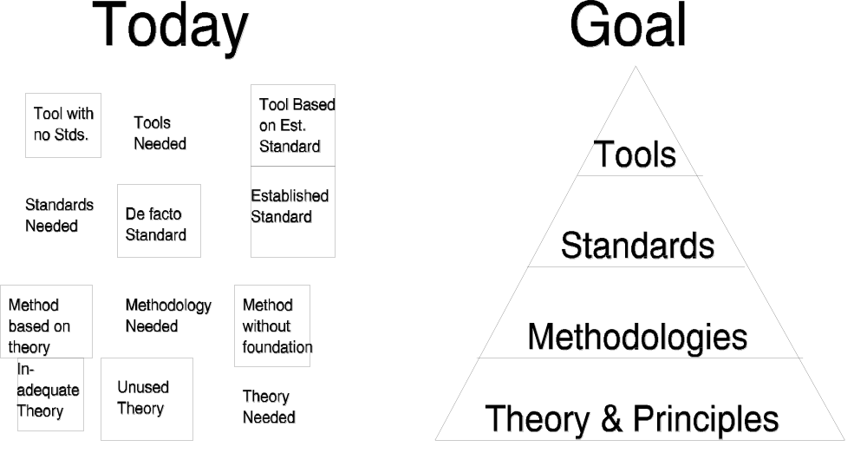
The Current State of
Software Engineering

Slide 81
Three key Challenges
Software engineering in the 21st century faces three key challenges:
Legacy systems
  Old, valuable systems must be maintained and updated
Heterogeneity
  Systems are distributed and include a mix of hardware and software
Delivery
  There is increasing pressure for faster delivery of software

Slide 82
Ever-Present Difficulties
Few guiding scientific principles
Few universally applicable methods
As much
managerial / psychological / sociological
as technological

Slide 83
Future of SE …
Process
Requirements engineering
Reverse engineering
Testing
Maintenance and Evolution
Software architecture
OO Modeling
SE and Middleware
Tools and environments
Configuration management
Databases and SE
SE Education
Software analysis
Formal specification
Mathematical foundations
Reliability and Dependability
Performance
SE for Safety
SE for security
SE for mobility
SE & the Internet
Software economics
Empirical studies of SE
Software metrics

